Slide 1
Microsoft Power Automate Desktop
Date

Slide 2

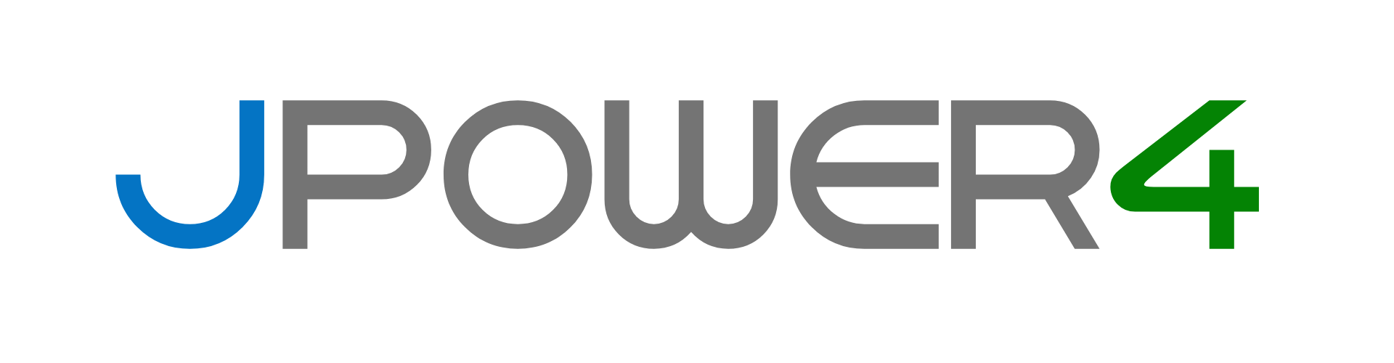

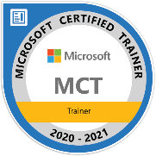
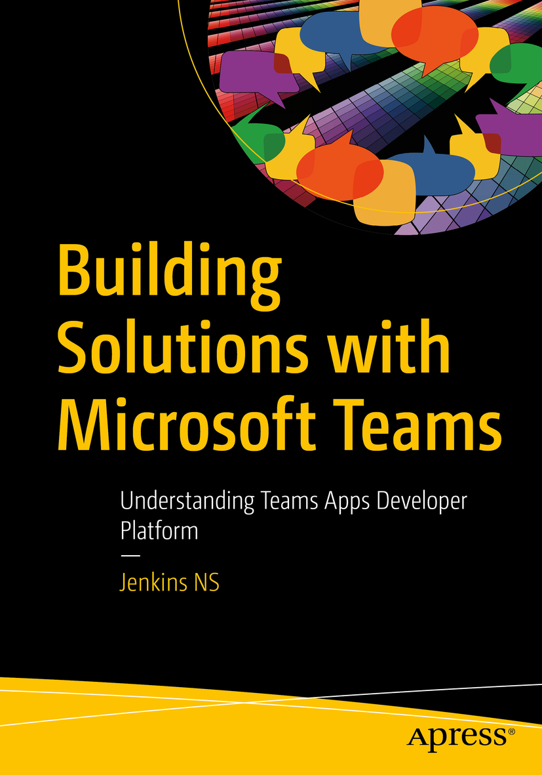








Jenkins NS
Modern Workplace Solution Architect | Consultant
Chennai, India
MVP | MCT | International Speaker | Author | Trainer
Microsoft Teams, Power Platform and SPFx Specialist
M365 Bangalore Organizer
aMS Ambassador
SharePoint-er Since 2005!
@jenkinsns
https://www.linkedin.com/in/jenkinsns/
https://www.youtube.com/user/jenkinsnss
Notes:
Hyperlinks in PowerPoint are active for the attendees if you use PowerPoint Live sharing in Teams.

Slide 3
What is Microsoft Power Platform?

Slide 4
Module 1 – Introduction
Explore the components that make up Power Platform and learn how they can work together to build Robotic Process Automation (RPA) solutions.
In this module, you will:
1
Identify the Power Automate ecosystem and offerings
2
Identify the differences between cloud flows and desktop flows
3
Identify use cases for Microsoft Dataverse
4
Explore Power Automate licensing for cloud and desktop flows
5
Learn the software and hardware requirements for Power Automate development
6
Understand how components can be managed in Microsoft Dataverse solutions
Notes:
Prerequisites
Basic familiarity with the Power Platform

Slide 5
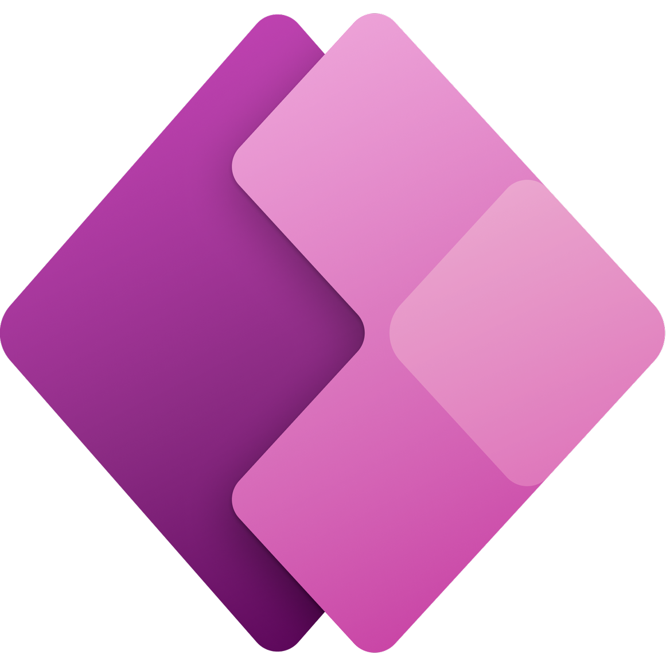

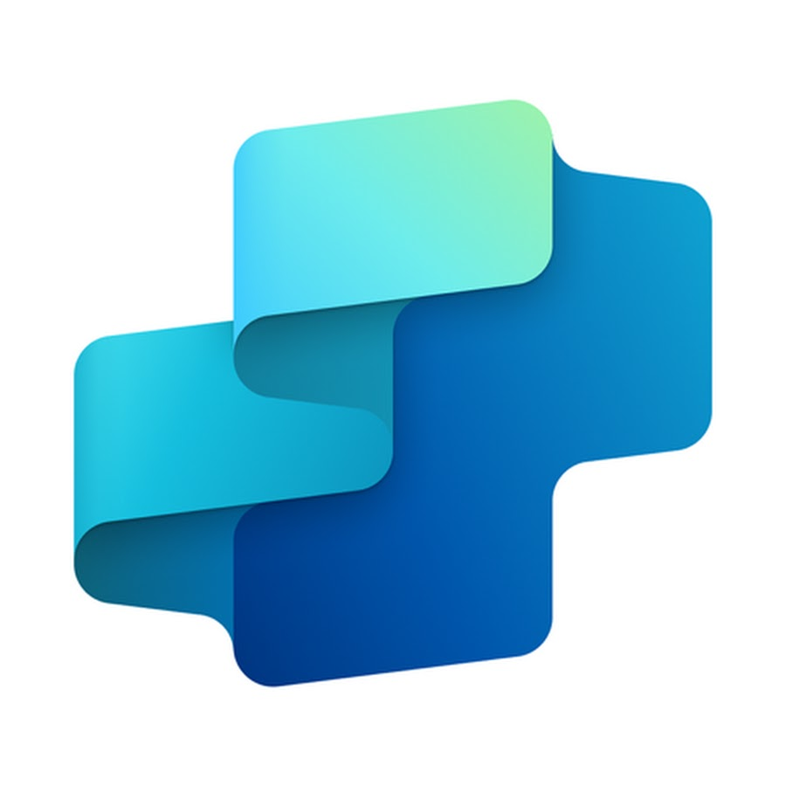
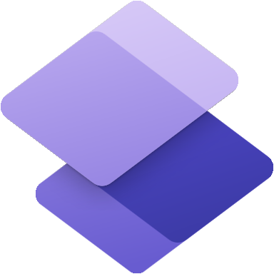



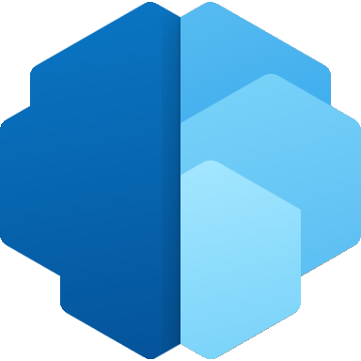



Microsoft Power Platform
Power Apps
Power Automate
Copilot Studio
Power Pages
Power BI
for web and mobile application development
for process or workflow automation
for creating and extending copilots
for
building secure, data-centric business websites
for data exploration, analytics and reporting
Data connectors
AI Builder
Microsoft Dataverse
Power Fx
Managed Environments
Notes:
Power Apps provides a rapid low code development environment for building custom apps for business needs. It has services, connectors, and a scalable data service and app platform (Microsoft Dataverse) to allow simple integration and interaction with existing data. Power Apps enables the creation of web and mobile applications that run on all devices.
Power Automate lets users create automated workflows between applications and services. It helps automate repetitive business processes such as communication, data collections, and decision approvals.
Power BI (Business Intelligence) is a business analytics service that delivers insights for analyzing data. It can share those insights through data visualizations which make up reports and dashboards to enable fast, informed decisions. Power BI scales across an organization, and it has built-in governance and security allowing businesses to focus on using data more than managing it.
Power Pages Construct websites for services like permitting, licensing, grant applications, and outage reporting.
Copilot Studio Enables anyone to create new or extend existing copilots using a guided, no-code graphical interface, without the need for data scientists or developers.

Slide 6
Working Together for a Complete RPA Solution
Power Apps
Power Power BI
Microsoft Dataverse
Power Pages
Copilot Studio
Power Automate
Notes:
While not every RPA solution will involve all Power Platform products, they can work together to solve larger challenges. Power Apps, Power Pages, and Power Virtual agents can start a RPA automation by updating data in Dataverse, or even directing triggering a Power Automate flow. Power Automate handles the automation and Power BI provides analytics on the overall process success.

Slide 7
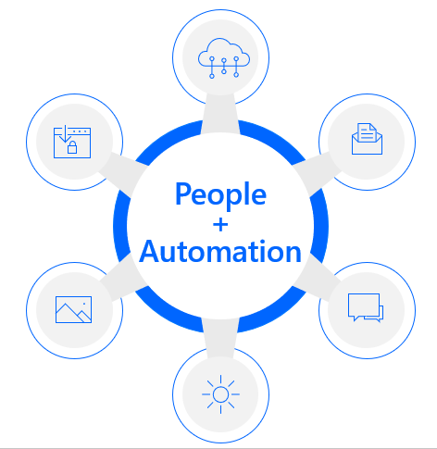
Why Power Automate
End-to-end intelligent automation for all
Unlock data potential with AI
Automate UI with RPA
Orchestrate APIs with built-in connectors
Notes:
For those who aren’t as familiar with Power Automate it is an end-to-end intelligent automation platform that brings together digital process automation (DPA) with API-based automation that you know in Power Automate today with the newest feature in Robotic Process Automation (RPA) with UI-based automation into a single cloud-based offering.
It enables everyone from end users and developers alike to build workflows that automate highly repetitive, manual, and time-consuming tasks across legacy, on-prem, and cloud apps and services.
With Power Automate we are empowering organizations to do more with less.
Microsoft Power Automate is a low-code automation platform that unlocks analog data with AI, automates UI with RPA, and orchestrates APIs with DPA–a single cloud-based automation platform.

Slide 8
Power Automate
Cloud Flows
Desktop Flows
Runs in the cloud
Uses connectors
Can run desktop flows
Can’t interact with local machine resources
Runs locally
Uses actions
Can create by recording user actions
Can interact with local machine resources

Slide 9
Types of Cloud Flows
Automated flows
Instant flows
Scheduled flows
Cloud Flows
Notes:
More on the types here https://docs.microsoft.com/en-us/power-automate/getting-started#types-of-flows

Slide 10
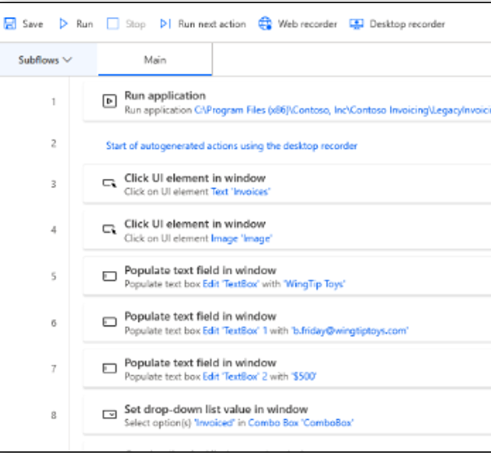
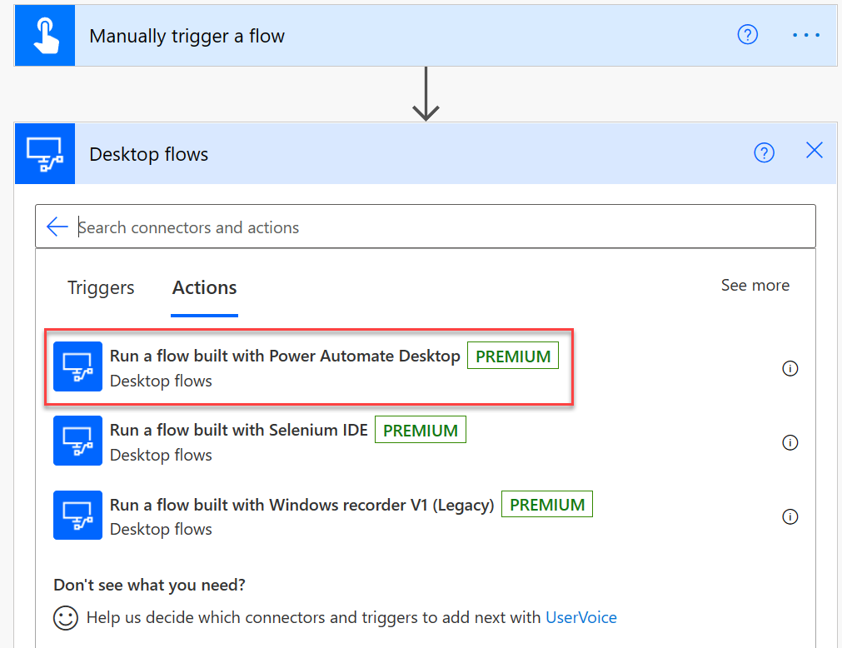
Automating with Desktop Flows
Record user using an application (web or Windows)
Replace hard-coded input values with dynamic content
Run recorded automation as part of a larger Power Automate cloud flow
Notes:
To use robotic process automation you record the actions in an application that doesn't have an API those recorded actions become a desktop flow that can be used as part of a bigger flow
in the example we show using a manual trigger to run a flow which might collect some parameters from the user in the mobile device and it runs a desktop flow that was recorded on the desktop automating the legacy application

Slide 11
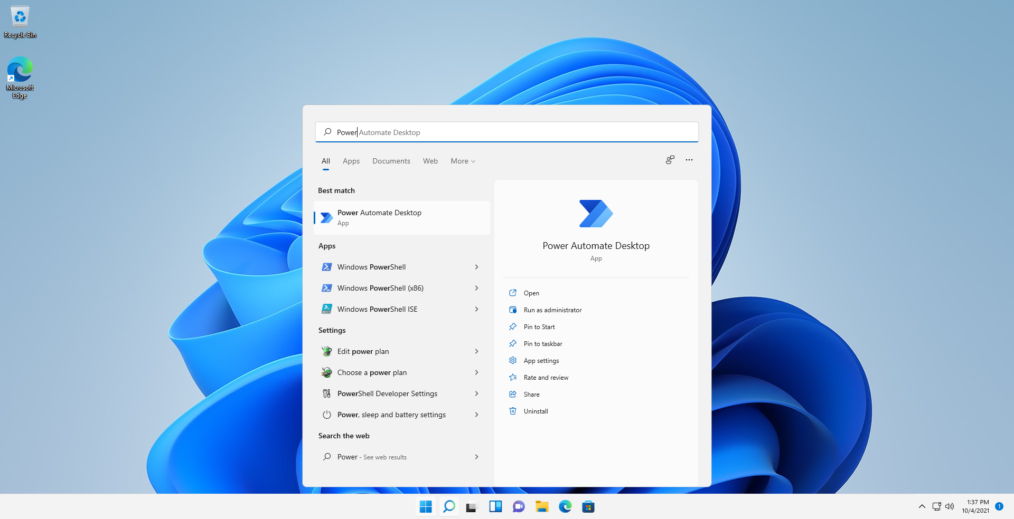
Installing Power Automate Desktop
You can download and install Power Automate using an MSI installer or from Microsoft Store.
Duplicate installations on the same machine may cause issues and isn’t recommended.
Minimum hardware | Recommended hardware
Processor: 1.00 GHz or faster with two or more cores | Processor: 1.60 GHz or faster with two or more cores
For unattended mode, four or more cores are needed.
Storage: 1 GB RAM: 2 GB | Storage: 2 GB RAM: 4 GB
 | GPU acceleration .NET Framework 4.7.2 or later
Notes:
https://learn.microsoft.com/en-us/power-automate/desktop-flows/install
Using the MSI is only required by non-Windows 11 machines
You can download and install Power Automate using an MSI installer or from Microsoft Store. Microsoft Store installation doesn't require you to have admin rights on your device.
You should choose one option only. Duplicate installations on the same machine may cause issues and isn't recommended.

Slide 12
Power Automate Licensing
Per-user plan
Per-user plan with RPA
Per-flow plan
Allow individuals to automate cloud apps, services, and data with digital process automation (DPA). This plan allows people to create and run unlimited flows.
Allow the same capabilities as the base plan, plus the ability to automate legacy apps on a desktop via robotic process automation (RPA) in attended mode.
Allow an unlimited number of people within an organization to run digital process automation (DPA) from the same flow.
Cloud flows (DPA)
Cloud flows (DPA) Desktop flows (RPA) in attended mod
Cloud flows (DPA)
Notes:
Power Automate also offers Pay-as-you-go https://learn.microsoft.com/en-us/power-platform/admin/pay-as-you-go-overview

Slide 13
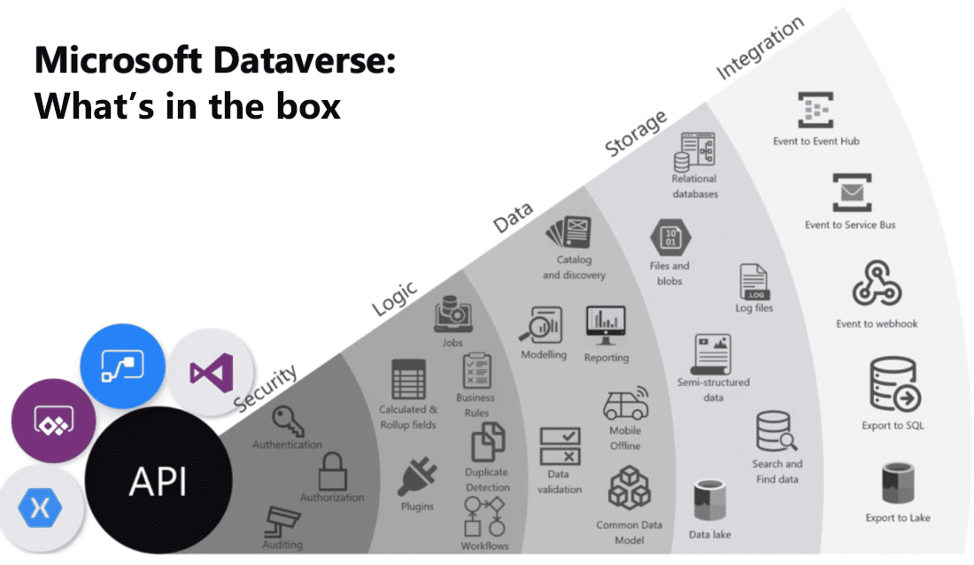
Microsoft Dataverse
Microsoft Dataverse is a cloud-based, low-code data service and app platform, that easily structures a variety of data and business logic to support interconnected applications and processes in a secure and compliant manner.
Notes:
Microsoft Dataverse is a cloud-based, low-code data service and app platform, which allows you to leverage the security and connectivity of Microsoft services. Dataverse connects easily to all aspects of Microsoft Power Platform so that you can fully control, automate, and strengthen your business. With standard tables and columns, as well as the ability to easily define relationships between your data, Dataverse was built for powerful, scalable solutions.
Microsoft Dataverse is a cloud-based solution that easily structures a variety of data and business logic to support interconnected applications and processes in a secure and compliant manner. Managed and maintained by Microsoft, Dataverse is available globally but deployed geographically to comply with your potential data residency. It is not designed for stand-alone use on your servers, so you will need an internet connection to access and use it.
Dataverse is designed to be your central data repository for business data, and you might even be using it already. Behind the scenes, it powers many Microsoft Dynamics 365 solutions such as Field Service, Marketing, Customer Service, and Sales. It is also available as part of Power Apps and Power Automate with native connectivity built right in. The AI Builder and Portals features of Microsoft Power Platform also utilize Dataverse.
Below is a visualization that brings together the many offerings of Microsoft Dataverse.
As you can see, Microsoft Dataverse offers a great deal of functionality. Below is a brief explanation of each category of features.
Security: Dataverse handles authentication with Azure Active Directory (Azure AD) to allow for conditional access and multi-factor authentication. It supports authorization down to the row and column level and provides rich auditing capabilities.
Logic: Dataverse allows you to easily apply business logic at the data level. Regardless of how a user is interacting with the data, the same rules apply. These rules could be related to duplicate detection, business rules, workflows, or more.
Data: Dataverse offers you the control to shape your data, allowing you to discover, model, validate, and report on your data. This control ensures your data looks the way you want regardless of how it is used.
Storage: Dataverse stores your physical data in the Azure cloud. This cloud-based storage removes the burden of worrying about where your data lives or how it scales. These concerns are all handled for you.
Integration: Dataverse connects in different ways to support your business needs. APIs, webhooks, eventing, and data exports give you flexibility to get data in and out.
As you can see, Microsoft Dataverse is a very powerful cloud-based solution for storing and working with your business data. In the following sections, you will look at Microsoft Dataverse from the lens of data storage for Microsoft Power Platform, where you will start your journey. Keep in mind the additional rich capabilities discussed above which you can explore further as your usage increases.
To get started, Microsoft Dataverse lets you create one or many cloud-based instances of a standardized database. The database includes predefined tables and columns which store data commonly found across nearly all organizations and businesses. You can customize and extend what is stored by adding new columns or tables. The ease of setting up a Microsoft Dataverse database and standardized data model under it simplifies your ability to concentrate your efforts on building solutions without worrying about infrastructure, storage, and data integration. With your data stored in Microsoft Dataverse, there are many different ways to access it. You can work with the data natively with tools such as Power Apps or Power Automate. Or through connectors and APIs you can connect to Microsoft Dataverse from any business solution. With the power of features such as role-based security and business rules you can trust your data is safe no matter how it is accessed.

Slide 14
Benefits of Microsoft Dataverse
1
Simple to manage – Both the metadata and data are stored in the cloud. You don't need to worry about the details of how they’re stored.
2
Helps to secure data – Data is stored so that users can see it only if you grant them access. Role-based security allows you to control access to tables for different users within your organization.
Access your Dynamics 365 data – Data from your Dynamics 365 applications is also stored within Dataverse, which allows you to quickly build apps that use your Dynamics 365 data and extend your apps by using Power Apps.
3
4
Rich metadata – Data types and relationships are used directly within Power Apps.
5
Logic and validation – Define calculated columns, business rules, workflows, and business process flows to ensure data quality and drive business processes.
6
Productivity tools – Tables are available within the add-ins for Microsoft Excel to increase productivity and ensure data accessibility.
Notes:
Whether you are building a canvas app or a model-driven app, Dataverse is the ideal data source because it is the foundational data source of Microsoft Power Platform. As a result, you will experience the most functionality, the deepest integrations, the most features, and the best ease-of-use of any available data sources. From simple web-based data design to robust, role-based security, Microsoft Dataverse is a straightforward platform that you can use to begin designing your data structures and helping to keep them safe. Then, with your data in place, you have rich integration capabilities from Power Apps and the rest of Microsoft Power Platform. Additionally, by applying business rules, you can trust that your business integrity will be maintained no matter what tool you use to interact with the data.
Another benefit of using Dataverse is that all of your data is stored in tables. A table is a set of records that is used to store data, similar to how a table stores data within a database. Dataverse includes a base set of standard tables that cover typical scenarios, but you can also create custom tables that are specific to your organization. Standard and custom tables within Dataverse help provide a secure and cloud-based storage option for your data. Tables allow you to create a business-focused definition of your organization's data for use within apps.
Some benefits of using Dataverse and its tables include:
Simple to manage - Both the metadata and data are stored in the cloud. You don't need to worry about the details of how they're stored.
Helps to secure data - Data is stored so that users can see it only if you grant them access. Role-based security allows you to control access to tables for different users within your organization.
Access your Dynamics 365 Data - Data from your Dynamics 365 applications is also stored within the Dataverse, which allows you to quickly build apps that use your Dynamics 365 data and extend your apps by using Power Apps.
Rich metadata - Data types and relationships are used directly within Power Apps.
Logic and validation - Define calculated columns, business rules, workflows, and business process flows to ensure data quality and drive business processes.
Productivity tools - Tables are available within the add-ins for Microsoft Excel to increase productivity and ensure data accessibility.

Slide 15
Dataverse Defined
1
A Dataverse database is a single instance of Microsoft Dataverse which stores data in a set of standard and custom data structures called tables.
2
A Dataverse database is scalable and supports both large data sets and complex data models.
The standard table design in a Microsoft Dataverse database is based upon an open data model standard called Common Data Model. The structure of a Microsoft Dataverse database is based upon the definitions and schema in the Common Data Model.
3
4
Dataverse contains comprehensive business logic, processing, integration, and security features that aid the building of business solutions.
Notes:
A Dataverse database is a single instance of Microsoft Dataverse which stores data in a set of standard and custom data structures called tables. A table is a logical set of rows that is used to store data. Rows within a table contain many columns to manage individual pieces of information about a single row.
You can create one or many database instances in Microsoft Dataverse to host data behind your business solutions. Each instance of a Microsoft Dataverse will start with the same set of tables to store data, but you can always extend and customize a Microsoft Dataverse database to meet specific business needs. This means that you can share business solutions that reference standard tables in Microsoft Dataverse across your organization or with any other organization by using it anywhere in the world.
A Dataverse database supports large data sets and complex data models. Tables can hold millions of items, and you can extend the storage in each instance of a Microsoft Dataverse database to four (4) terabytes per instance. The amount of data that is available in your instance of Microsoft Dataverse is based upon the number and type of licenses that are associated with it. Data storage is pooled between all licensed users, so you can allocate storage as needed for each solution that you build. Additional storage can be purchased if you need more storage than what is offered within standard licensing.
Tip: Dataverse supports transactional multi-user applications, where quick response to user demand is the priority. It is not intended to be a platform for long running or batch processing.
The standard table design in a Microsoft Dataverse database is based upon an open data model standard called Common Data Model. Common Data Model is a logical design that includes a set of open-sourced, standardized, extensible data tables and relationships that Microsoft and its partners have published in an industry-wide initiative called the Open Data Initiative. This collection of predefined tables, columns, semantic metadata, and relationships form the basis of the Common Data Model. The structure of a Microsoft Dataverse database is based upon the definitions and schema in the Common Data Model. The key benefit of using Common Data Model as the basis of a Microsoft Dataverse database is simplified integration of any solutions that use a Common Data Model schema, because the standard tables of the solution are the same. You will also be able to take advantage of a rich ecosystem of solutions that vendors have built from using Common Data Model. Best of all, there is practically no limit to how far you can extend a Microsoft Dataverse database.
Dataverse contains comprehensive business logic, processing, integration, and security features that aid the building of business solutions. These features are covered later in the course.

Slide 16
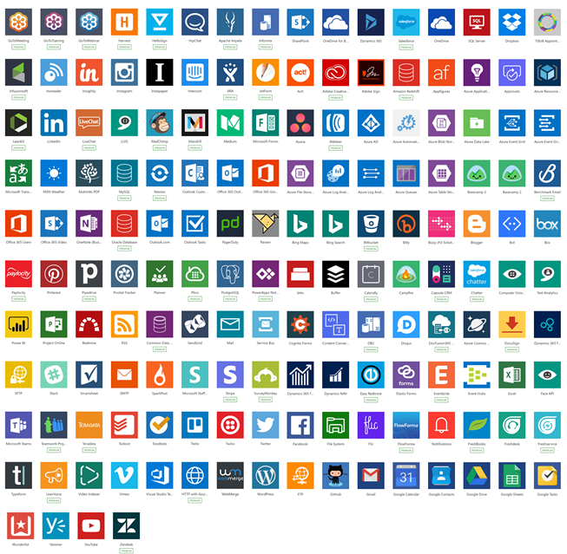
Connectors
Built-in connectivity to cloud services, files, databases, web APIs, etc. using public connectors
Seamless hybrid connectivity to on-premises systems via the on-premises data gateway
Connect to the service with your own security credentials Open source
https://github.com/microsoft/PowerPlatformConnectors
With custom connectors, you can extend the reach for your organization’s APIs to work with Power Platform
Over 1,000 published connectors

Slide 17
Using Dataverse Solutions with Power Platform
Solutions are a container to track the changes you make to the Microsoft Dataverse, Power Apps and Power Automate flows
Solutions are how you transport and install changes to target environments
Development
Test
Production
Microsoft Dynamics 365 apps are installed using solutions
3rd party apps provided by independent software vendors (ISVs) also use solutions
Notes:
Solutions are containers that track and manage customizations in a Microsoft Dataverse environment
If you have multiple environments, each would have their own set of solutions. Solutions can include table metadata, forms, views, business rules, processes definitions and other assets required to run the app; including components created by developers like scripts or compiled code.
when you have a Dynamics 365 application like Sales or Service those are installed using the same solution framework. 3rd party ISVs also ship their products using solutions
Solutions require Microsoft Dataverse, but do not require it be used by apps and flows as a data source

Slide 18
Exercise: Setup your Lab Environment
Follow the exercise on GitHub
Time estimate: 30 minutes
Notes:
Head to lab0 in github to setup your lab environment - https://github.com/MicrosoftLearning/PL-500T00-Microsoft-Power-Automate-RPA-Developer/blob/master/Instructions/L00/Lab00_Setup_Environment.md Trainer: this one exercise might be better if students follow you along as you show them how to step through it.

Slide 19
Module 1 – Summary
The Power Automate ecosystem and offerings
Differences between cloud flows and desktop flows
Use cases for Microsoft Dataverse
Power Automate licensing for cloud and desktop flows
The software and hardware requirements for Power Automate development
How components can be managed in Microsoft Dataverse solutions

Slide 20
Learning Path 0 Practice Labs
Lab 0: Validate lab environment
Prepare environments and solution
Notes:
Get your lab setup
Trainer: These exercises might be better if students follow you along as you show them how to step through it.

